Slide 1
Review
Arvin E

Slide 2
Context
SpringBoot
User Login
Postgresql
Password Encryption and Decryption
JSON Web Token
User And Admin Login
Html,Css,JavaScript,React
Excel Handling
Database Schema
FireBase Cloud Messaging
Critical Path Method
Project Management Application

Slide 3
Spring Boot
Learned Springboot and write efficient code in controller,service,repository and entity classes.
Learned to write Post,Get,Put,Delete Endpoints for API calls.
Learned to do Create , Read , Update and Delete Entities from DataBases.

Slide 4
User Login using Springboot
Created the User Login Backend Application using SpringBoot and Mysql.
User can perform CRUD Operations by using this Application

Slide 5
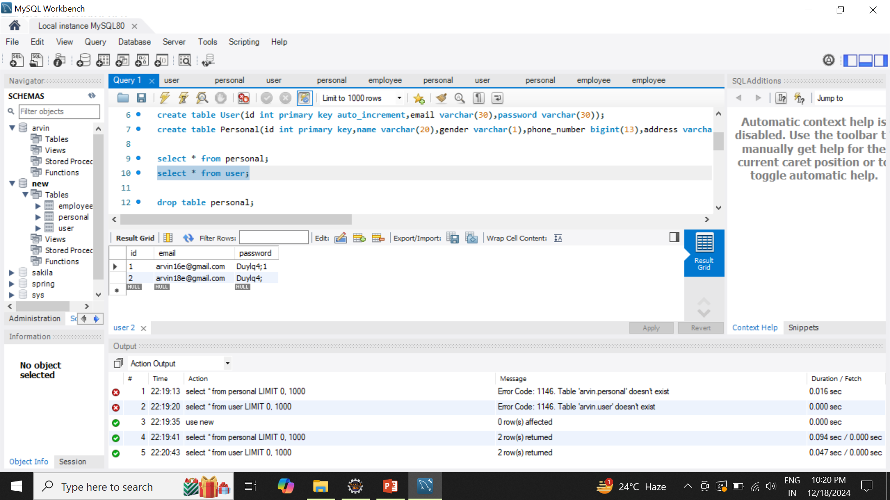

Slide 6
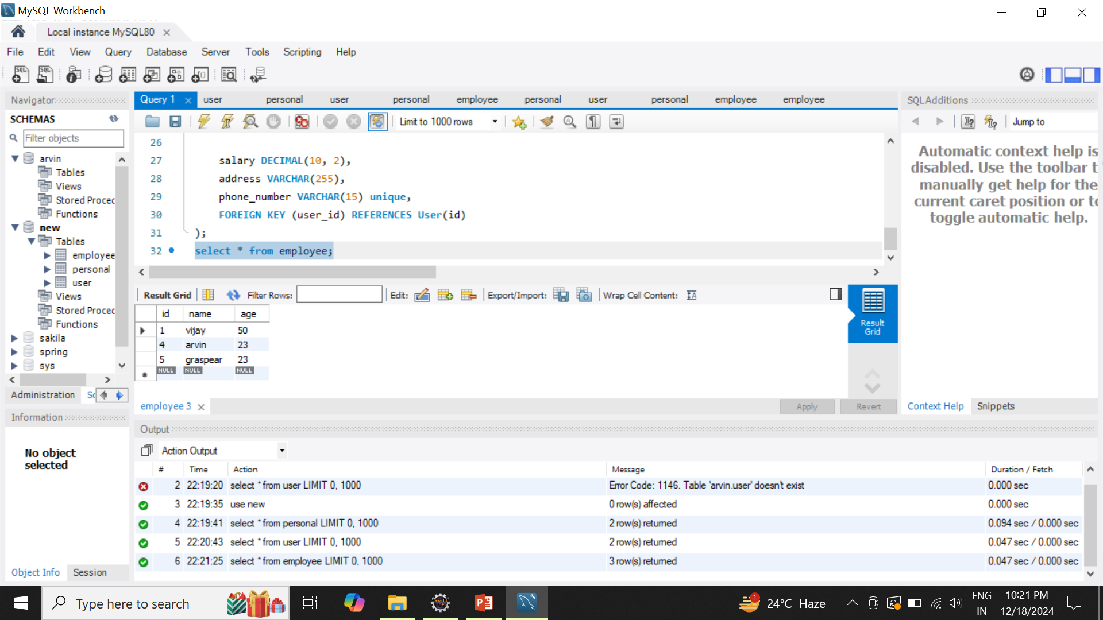

Slide 7
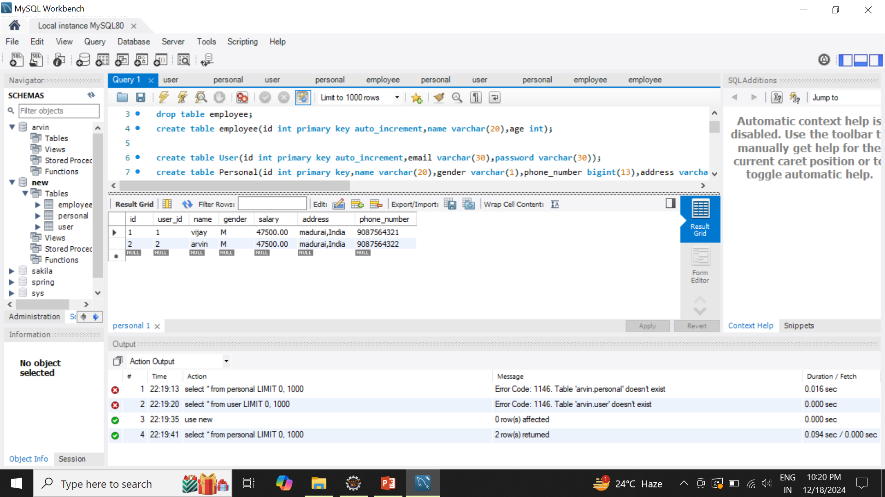

Slide 8
PostgreSql
Learned PostgreSql Database
Learned to do CRUD Operations in PostgreSql

Slide 9
Password Encryption and Decryption
Learned about Bcrypt Password Encoder
Learned about HmacSHA256 Algorithm
Learned to validate the Password

Slide 10
Json Web Token
Learned JWT
Learned about Authentication
Worked on Generating Tokens
Worked on Maintaining Sessions
Worked on Role based access in a Application using JWT

Slide 11
User And Admin Login
Created the User and Admin Login Backend Application using SpringBoot and Postgresql.
Endpoints are coded based on their Roles
User and Admin can perform CRUD Operations based on their role by using this Application
Sessions are Maintained and Passwords are Encrypted

Slide 12
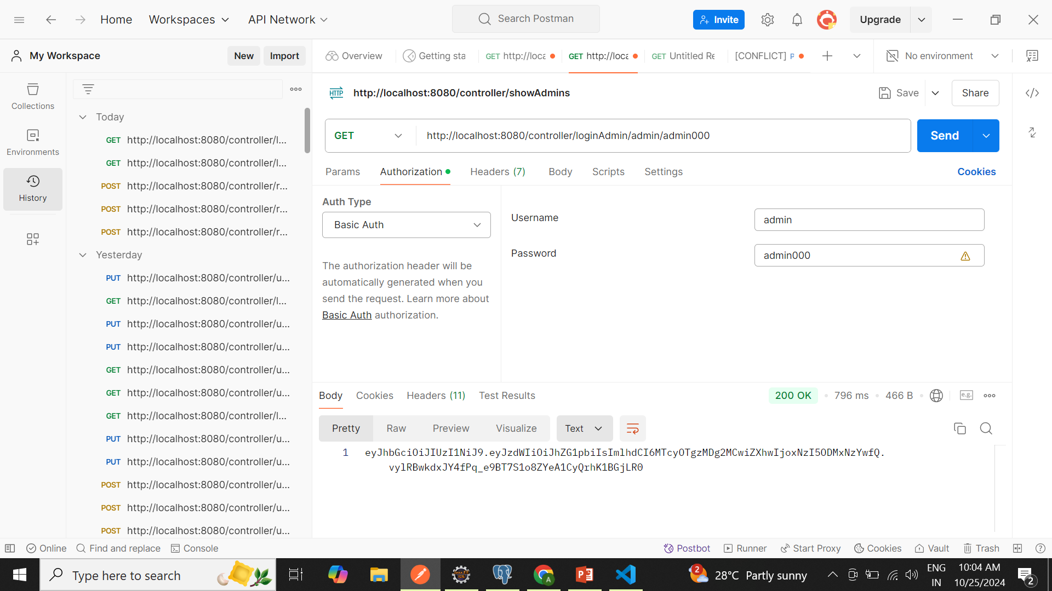

Slide 13
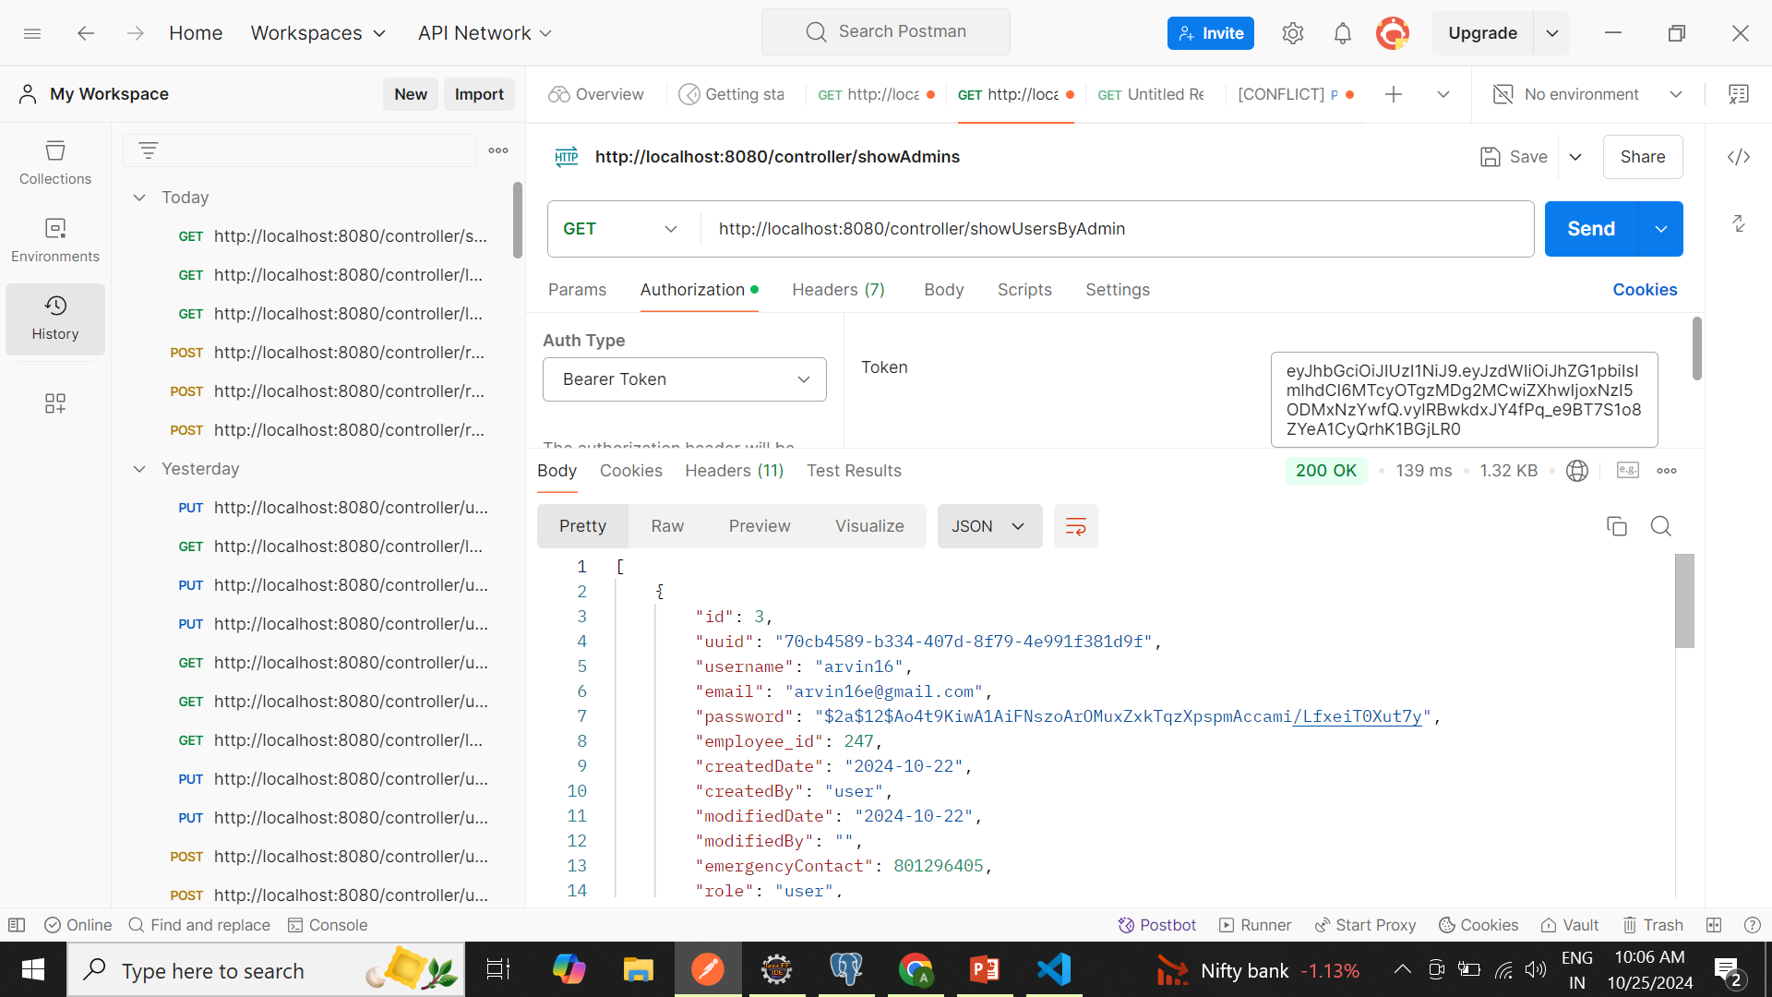

Slide 14
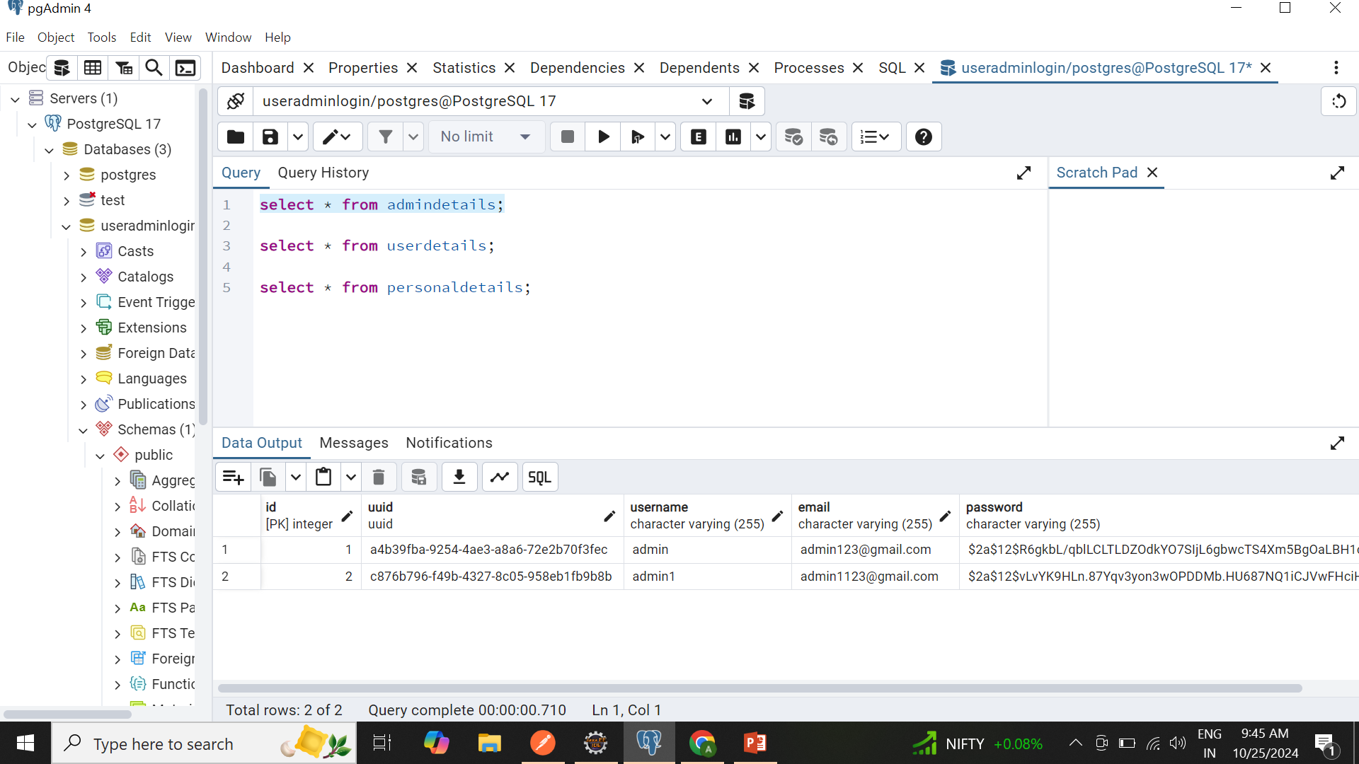

Slide 15
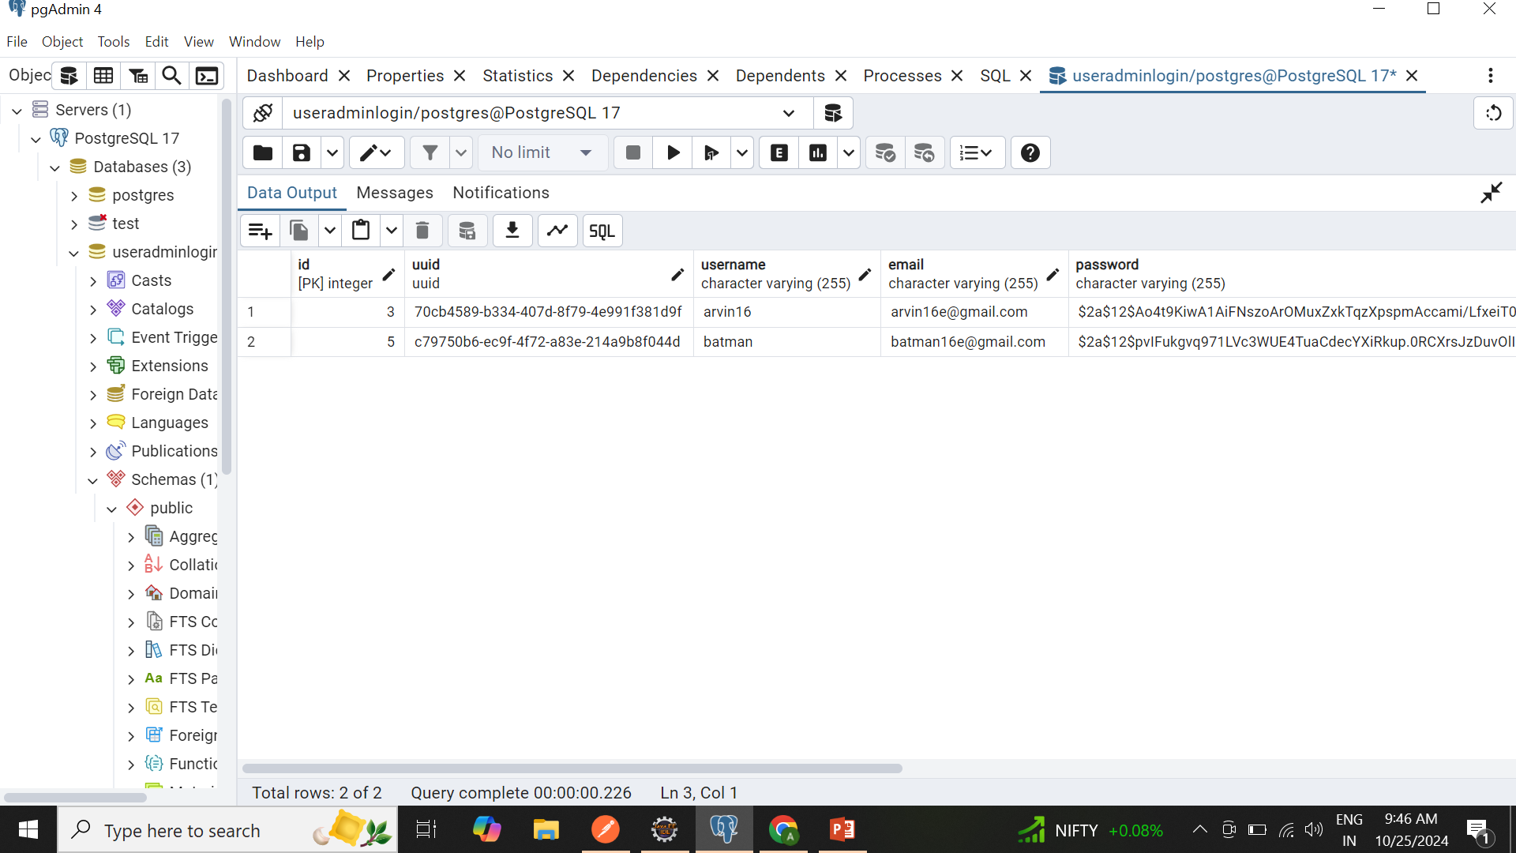

Slide 16
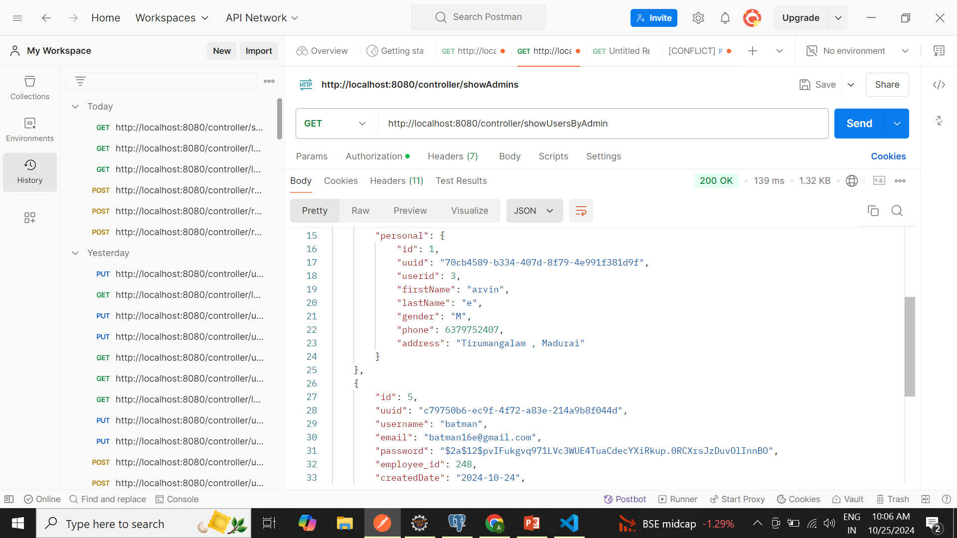

Slide 17
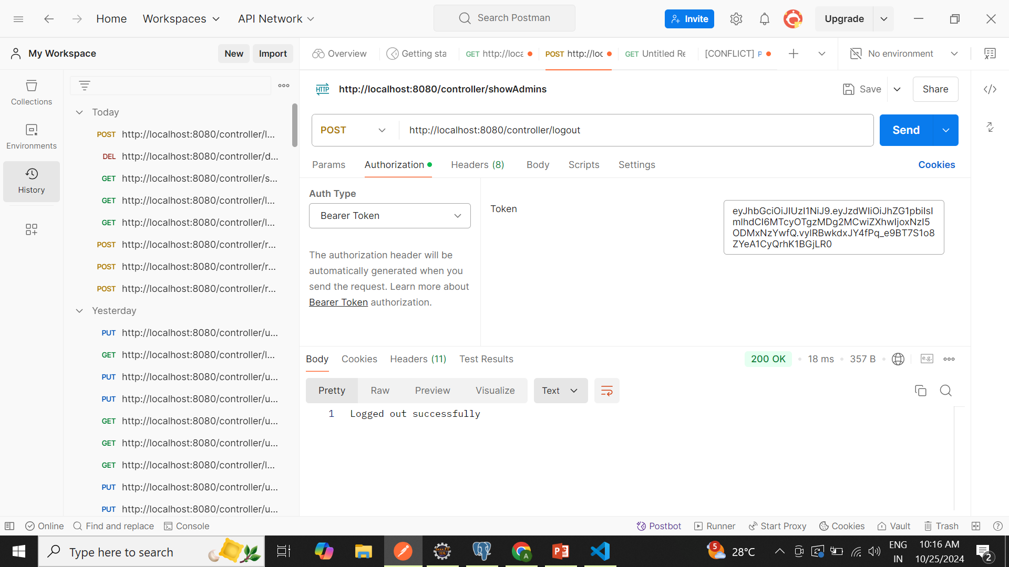

Slide 18
Front-End
Learned HTML
Learned CSS
Basics of JavaScript and React are Learned to work on Excel Sheet Handling
By using this , Worked on Excel Sheet Handling.
Created Simple UI that connects with Backend by API and Perform some Functionalities.

Slide 19
Excel Sheet Handling
In this Application User Gives Information and Uploads Excel sheet in User Interface.
Excel Sheet will be Validated and Details will be maintained in Databases.

Slide 20
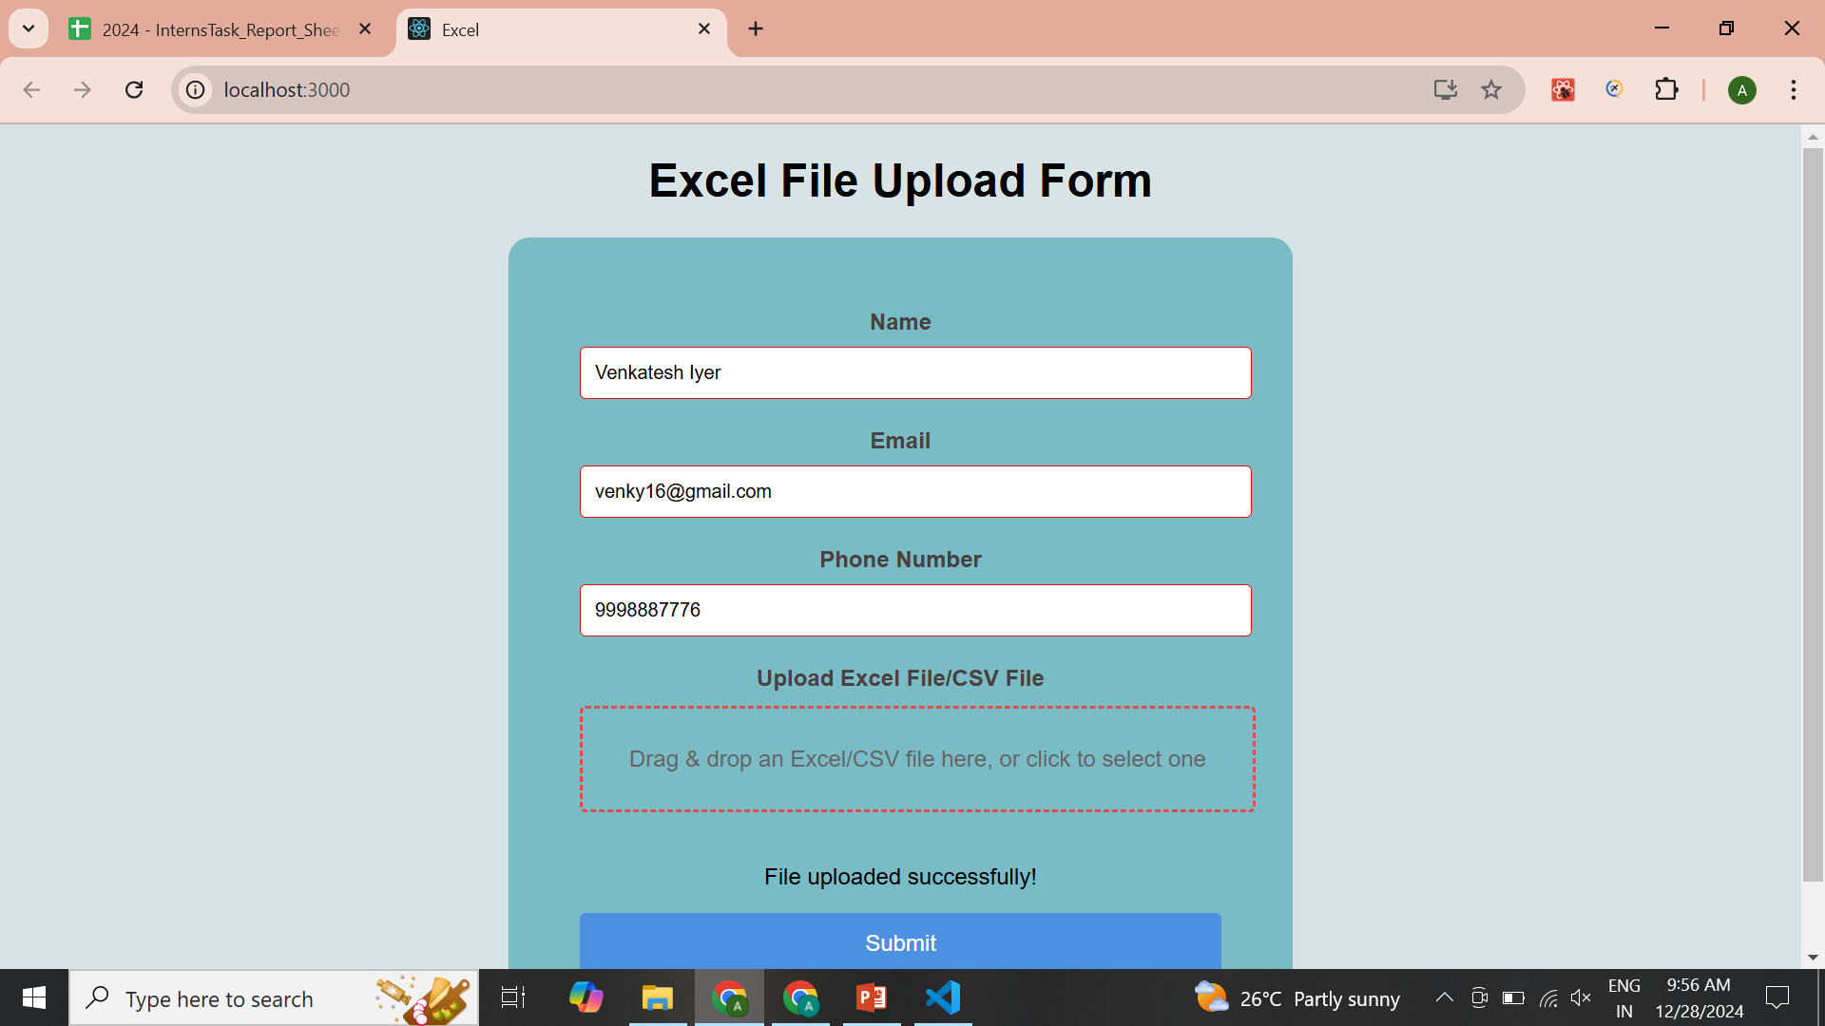

Slide 22
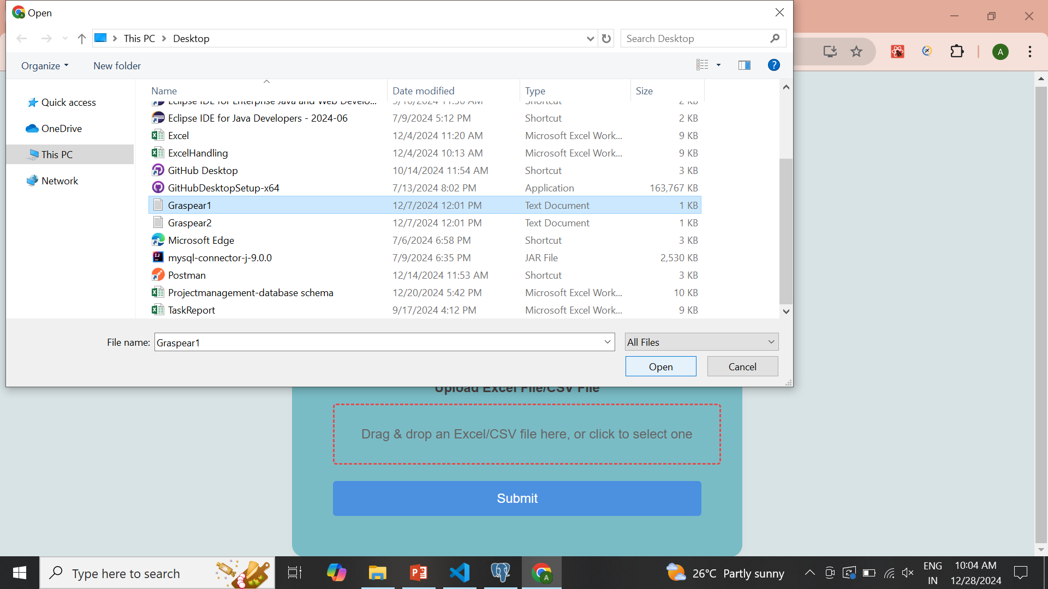

Slide 23
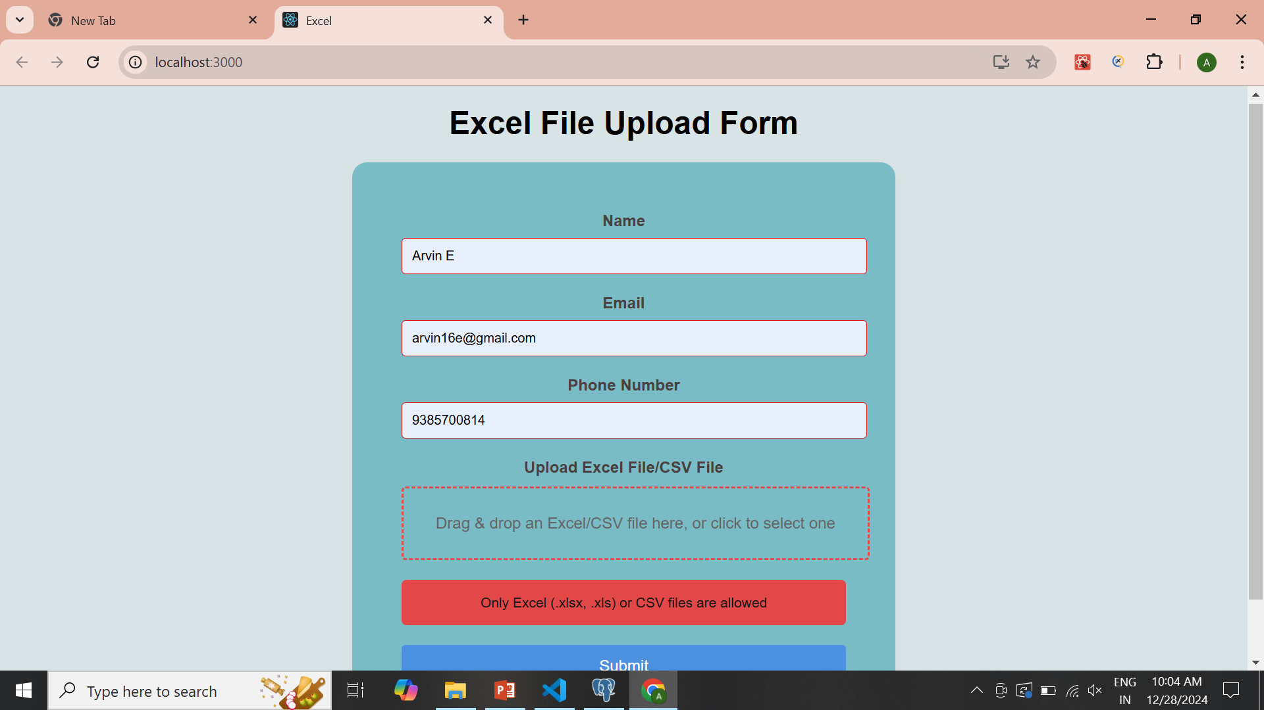

Slide 24
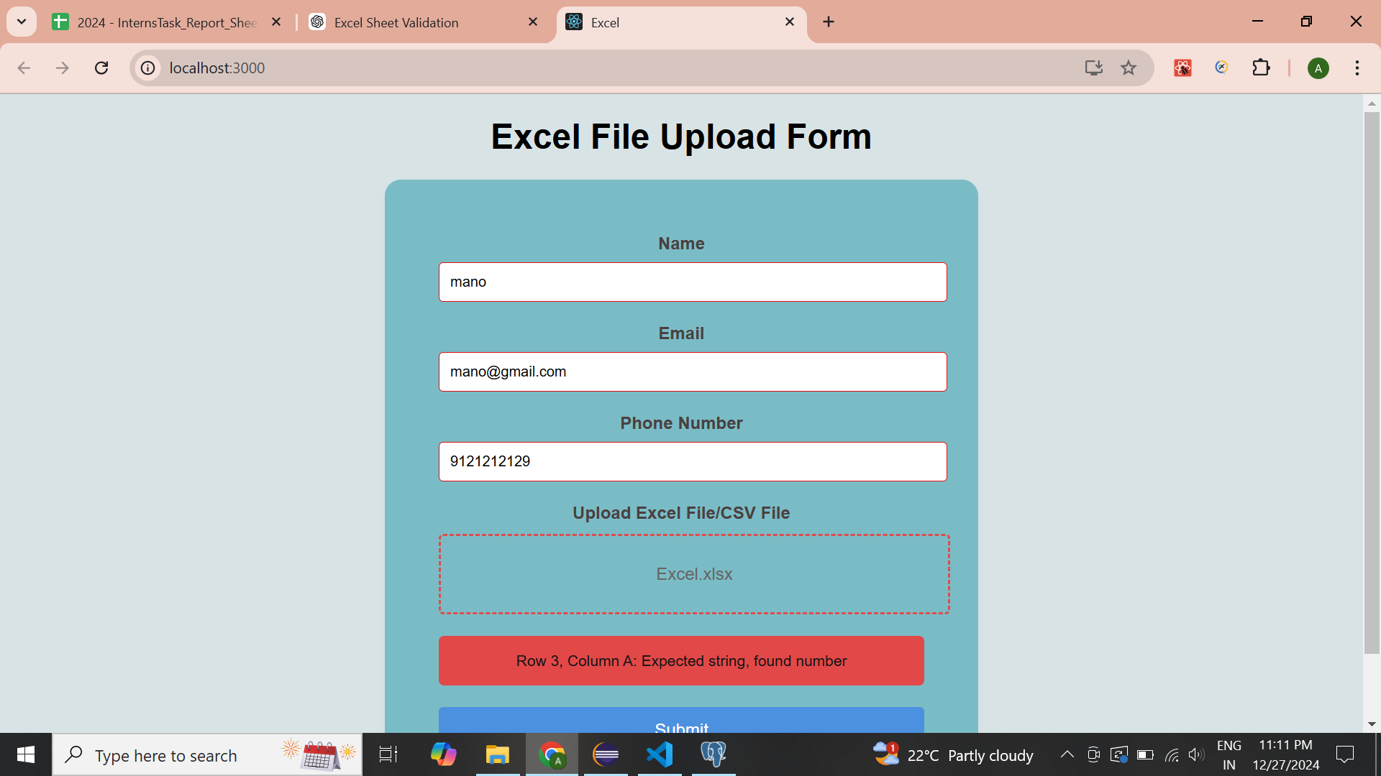

Slide 25
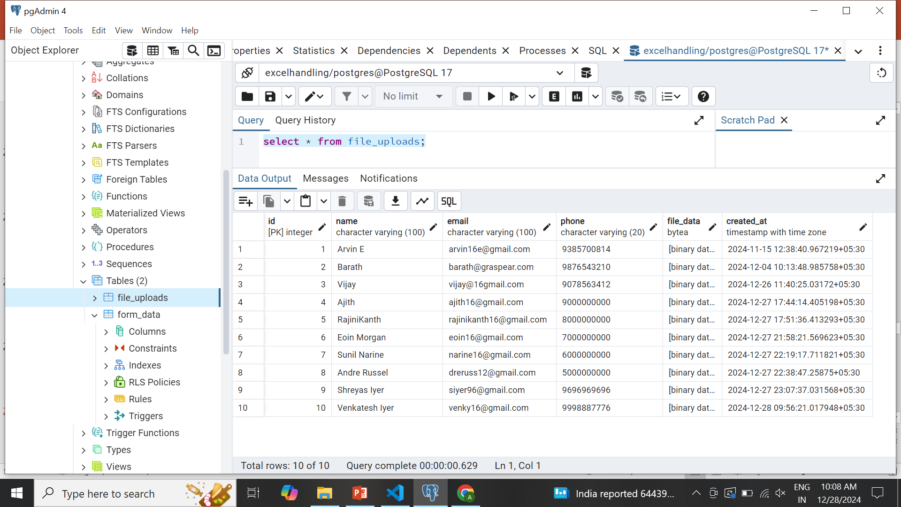

Slide 26
DataBase Schema
Learned to Designing and organizing data into structured tables.
Learned to Creating connections between tables using primary keys and foreign keys
Applying rules like NOT NULL, UNIQUE, CHECK, etc., to ensure data integrity.
Learned to Write Database Schema for Applications

Slide 27
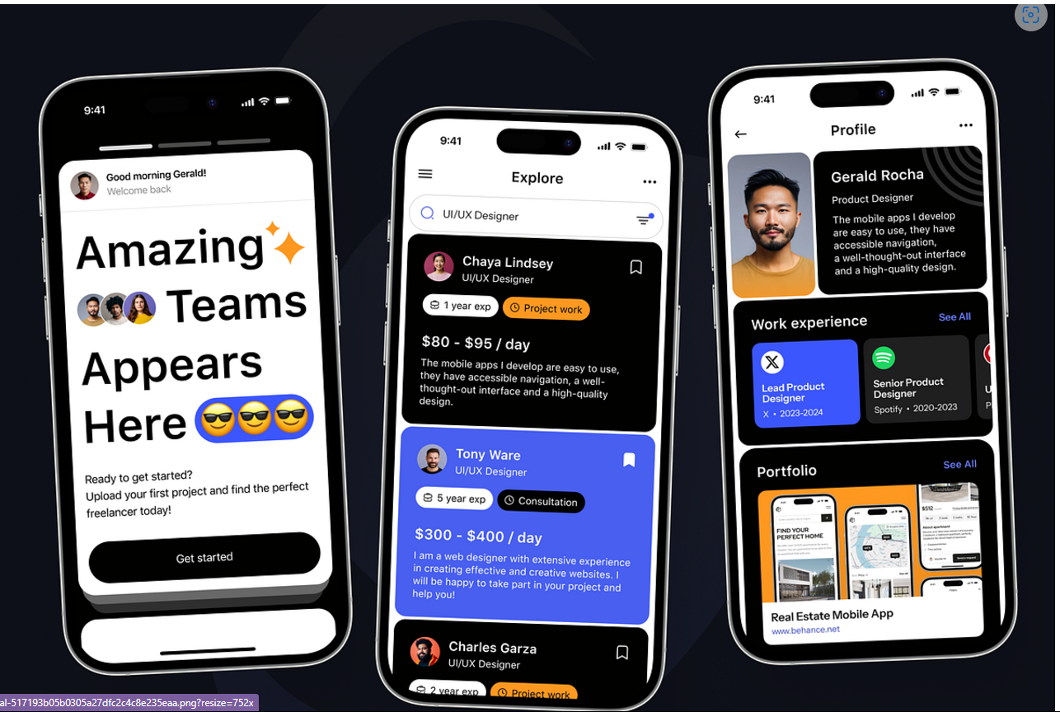

Slide 28
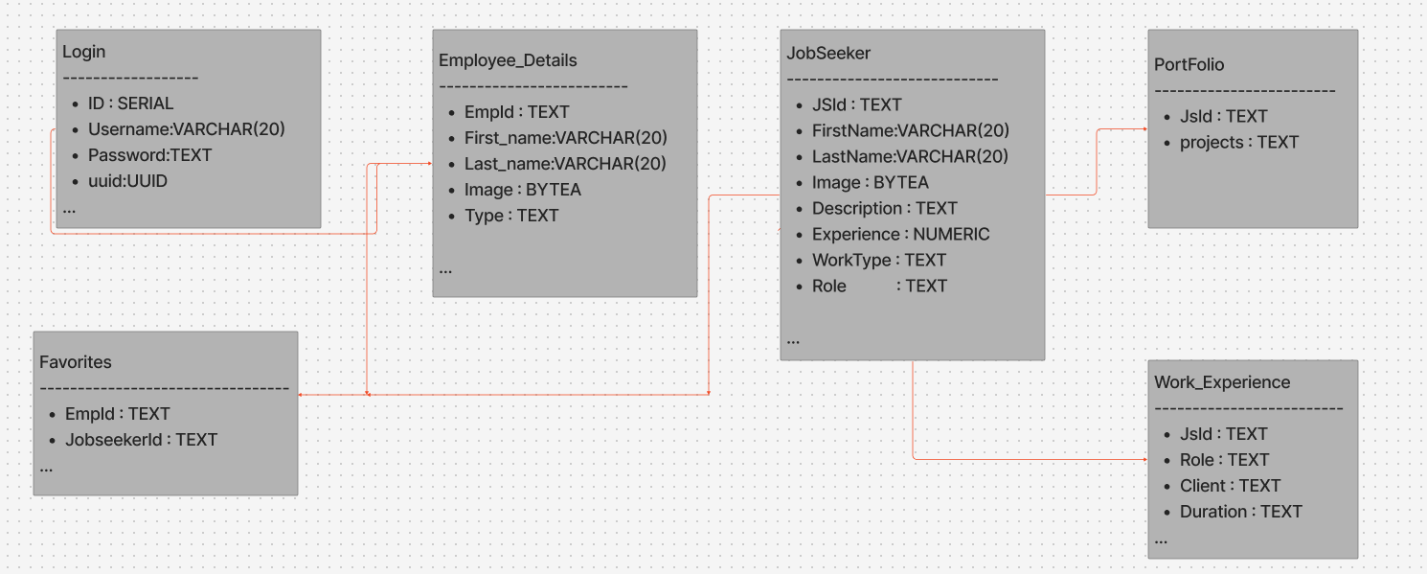

Slide 29
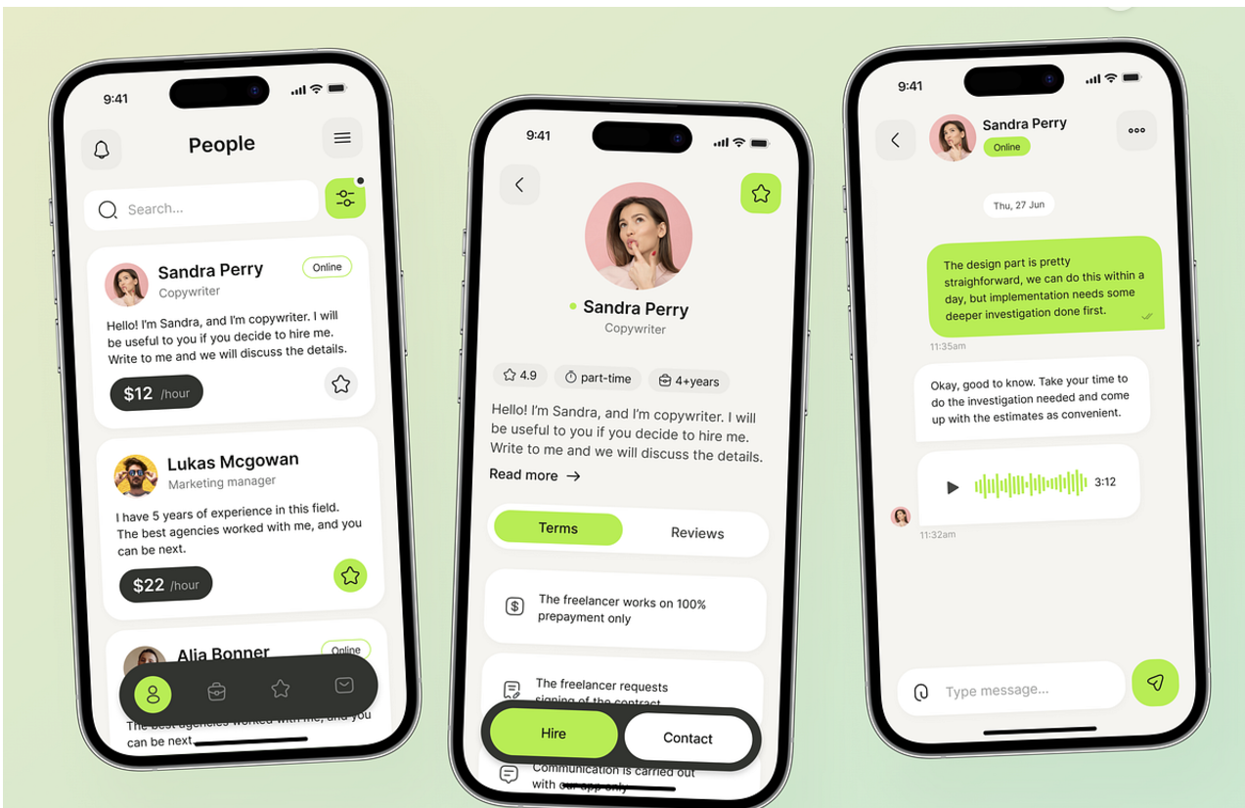

Slide 30
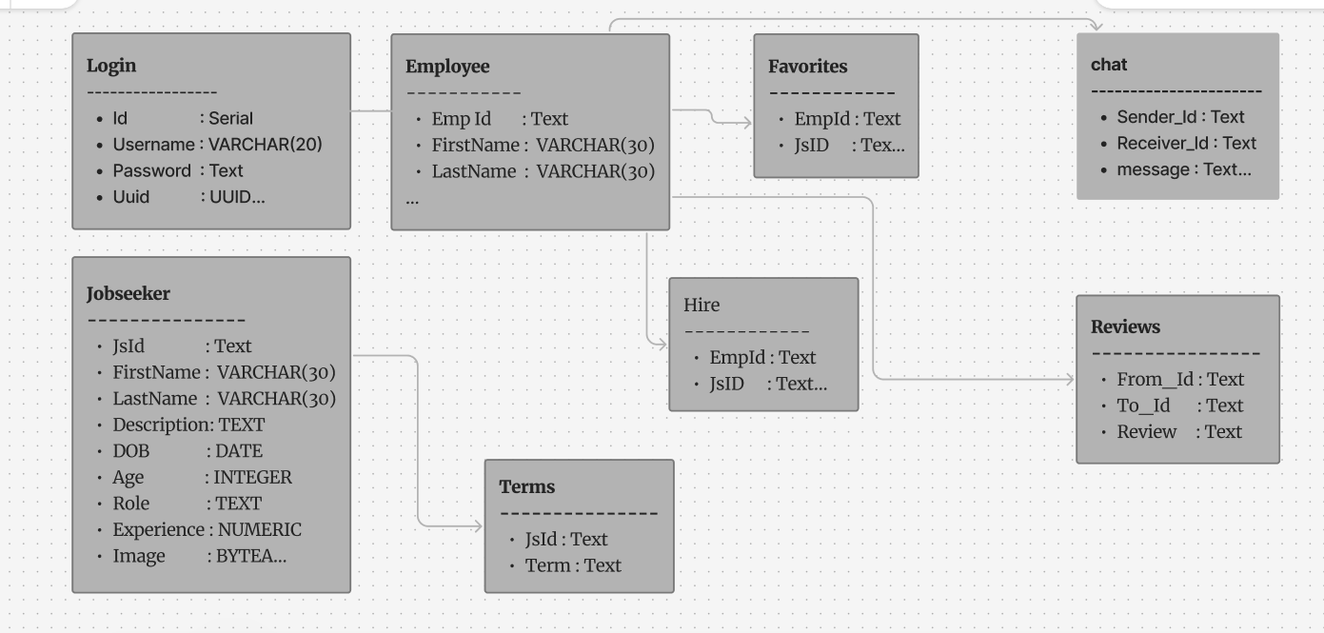

Slide 31
FireBase Cloud Messaging
Learned about Firebase cloud Messaging , Is a cross-platform messaging service provided by Google that enables developers to reliably deliver messages and notifications to devices running on Android, iOS, and web platforms.
Notification Messages : Delivered to the device's system tray (e.g., alerts, reminders).
FCM Broadcasting : Broadcasting in Firebase Cloud Messaging (FCM) refers to sending a single message or notification to multiple devices or users simultaneously.

Slide 32
Critical Path Method
The Critical Path Method (CPM) is a project management technique used to identify the sequence of critical tasks that determine the project’s minimum duration.
Key Concepts in CPM :
Critical Path: The longest path in the project with zero slack time.
Tasks/Activities: Individual tasks or activities in a project.
Dependencies: Relationships between tasks (e.g., start-to-start, finish-to-finish).
Slack Time: Time a task can be delayed without affecting the project deadline.

Slide 33
Project Management Application
Overview :
A robust platform to streamline project workflows and enhance team collaboration.
Built using Spring Boot (Backend) and Flutter (Frontend) for a scalable and responsive experience.
Key Features :
User Authentication
Role-Based Access Control
Image Uploads
4. Real-Time Notifications

Slide 34
